Slide 1
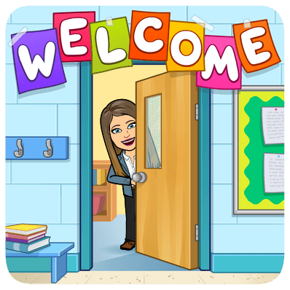
Perth Amboy High School Main Campus
2020-2021 School Year

Slide 2
About Ms. Landi:
English Teacher of Students with Disabilities
Kean University graduate
English Teacher for 11 years
9th year at Perth Amboy High School
Worked as the Sophomore Junior Class of 2021 Advisor
Working on my Masters Degree at Kean University
tinalandi@paps.net

Slide 3
English II Syllabus (Grade 10)
This year we will be covering the following:
Springboard Reading Workshop
Springboard Writing Workshop
Novel Study: The Great Gatsby
Drama Study: Julius Caesar
Springboard’s reading and writing programs allow the students to have a more focused instruction with practice in various crucial skills.

Slide 4
Grading Policy
35 % Classwork
5 % Homework
60 % Formal/Informal Assignments
(Tests, Projects, Quizzes, Essays)
Because we are in remote learning (and computers and the internet are sometimes unreliable), students will always be given extra time to complete assignments.

Slide 5
Class rules and expectations:
Be on time
Do not exit until they have been told to
Cameras must be on at all times and students must be in full view (participation points are deducted for noncompliance)
Students must be on mute at all times (unless they have a question)
Students should not be on their phones or playing video games
Students must be respectful

